Slide 1
.NET Development
.NET CORE API

Slide 2

API?
Application Programming Interface
APIs let your product or service communicate with other products and services without having to know how they’re implemented or forcing you to constantly build new connectivity infrastructure.
APIs simplify how developers integrate new application components into an existing architecture,
APIs are sometimes thought of as contracts, with documentation that represents an agreement between parties: If party 1 sends a remote request structured a particular way, this is how party 2’s software will respond.
This can simplify app development, saving time and money.
https://www.redhat.com/en/topics/api

Slide 3
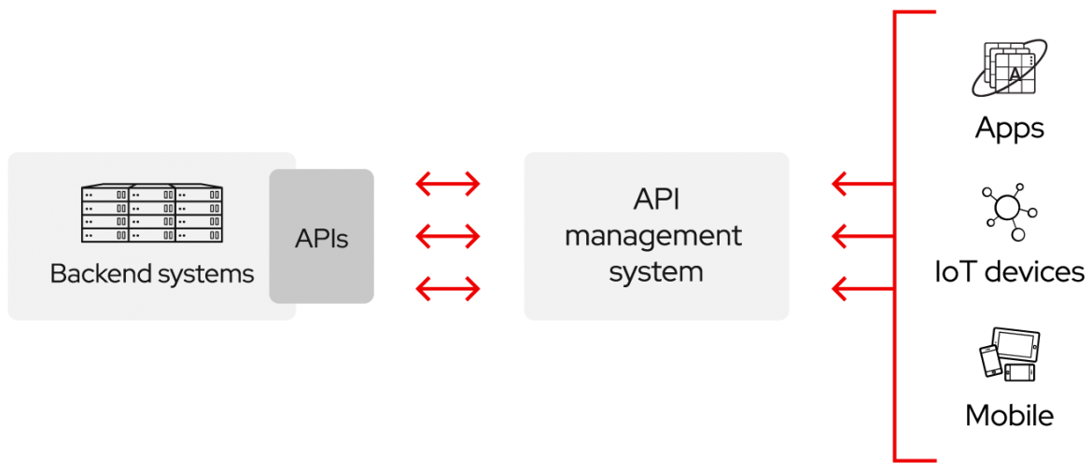
API?
APIs are about integration: the connection of data, applications, and devices across your IT organization so that all of your technologies can better communicate and work together.
https://www.redhat.com/en/topics/api
Notes:
https://www.redhat.com/en/topics/api/what-are-application-programming-interfaces

Slide 4
Why open your data for external use?
APIs are a simplified way to connect your own infrastructure through cloud-native app development, but they also allow you to share your data with customers and other external users.
Public APIs represent unique business value because they can simplify and expand how you connect with your partners, as well as potentially monetize your data because now external software developers can build apps based on your data.
Popular examples of public APIS:
Google Maps API – Google Translate API - …
Spotify API - Deezer API - ITunes API – Shazam API - …
Instagram API – Twitter API – Facebook API - …
IMDB
https://rapidapi.com/collection/popular-apis
Backend for your own application
REST – HTTP - JSON
https://www.redhat.com/en/topics/api

Slide 5
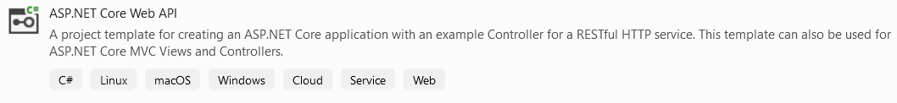
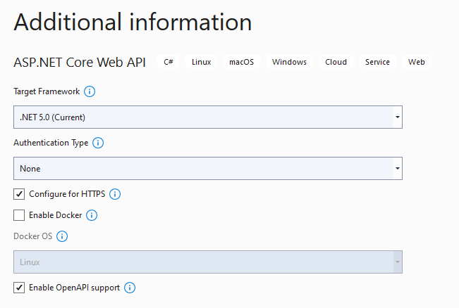
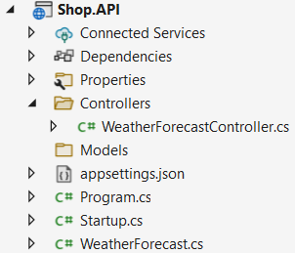
Create new ASP.NET Core Web API project
ASP.NET Core Web API
Name: Shop.API
.NET 5
Configure for HTTPS
No docker support
Enable OpenAPI support

Slide 6
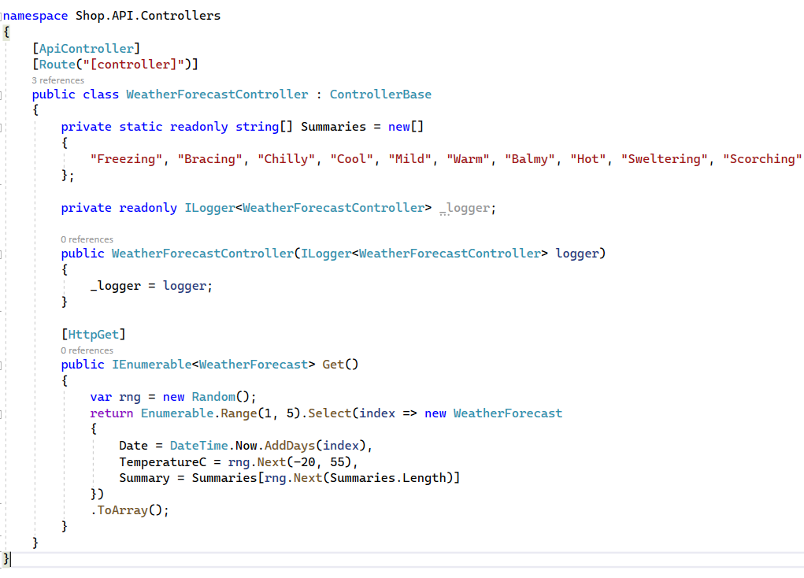
API : Collection of APIControllers
Data to be exposed
[HttpGet] → REST Endpoint
Returns collection with 5 WeatherForecast objects with random property values

Slide 7
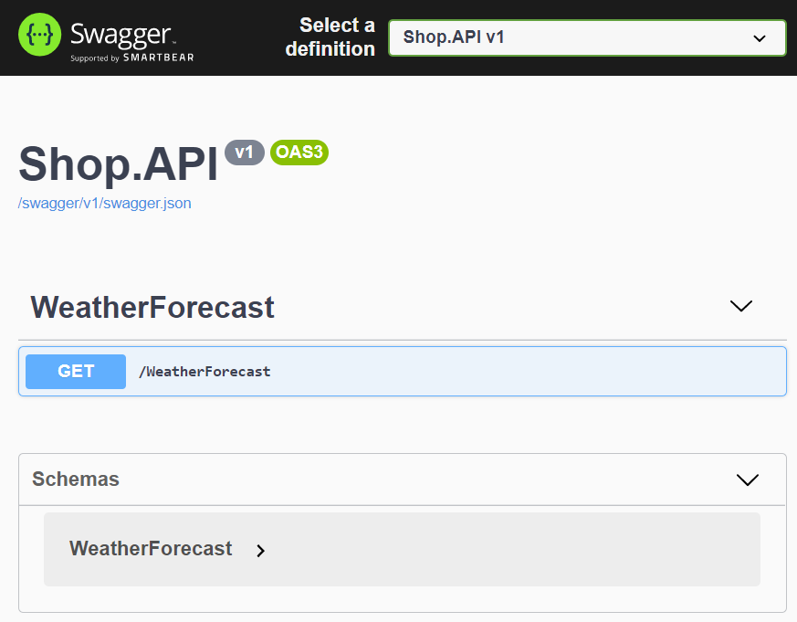
Test default API
Ctrl + F5
SwaggerUI
Web interface to test REST APIs
Each public action method in your controller can be tested
Service is called in startup.cs
Provides documentation about the API service, using OpenAPI
OpenAPI
language-agnostic specification for describing REST APIs. It allows both computers and humans to understand the capabilities of a REST API without direct access to the source code.
based on the XML and attribute annotations within the controllers and models.
Notes:
https://docs.microsoft.com/en-us/aspnet/core/tutorials/web-api-help-pages-using-swagger?view=aspnetcore-6.0
OpenAPI is a language-agnostic specification for describing REST APIs. It allows both computers and humans to understand the capabilities of a REST API without direct access to the source code. Its main goals are to:
Minimize the amount of work needed to connect decoupled services.
Reduce the amount of time needed to accurately document a service.
In short:
OpenAPI is a specification.
Swagger is tooling that uses the OpenAPI specification. For example, OpenAPIGenerator and SwaggerUI.
The OpenAPI specification is a document that describes the capabilities of your API. The document is based on the XML and attribute annotations within the controllers and models. It's the core part of the OpenAPI flow and is used to drive tooling such as SwaggerUI.
Swagger UI offers a web-based UI that provides information about the service, using the generated OpenAPI specification. Each public action method in your controllers can be tested from the UI. Select a method name to expand the section. Add any necessary parameters, and select Try it out!.

Slide 8
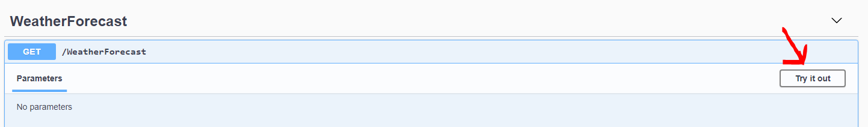
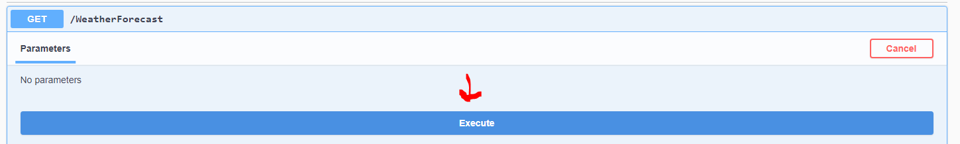
Test default API

Slide 9
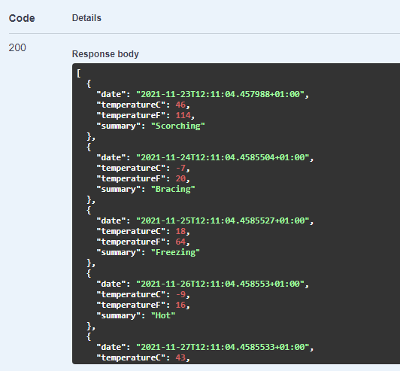
Test default API
Response: HTTP 200 status code indicates that the request has succeeded.
Collection with 5 WeatherForecast objects is returned

Slide 10
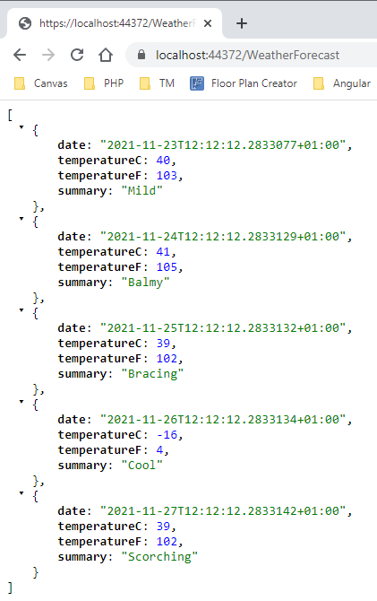
Test default API
Without Swagger
https://localhost:44372/WeatherForecast
Notes:
Port settings can be different.

Slide 11
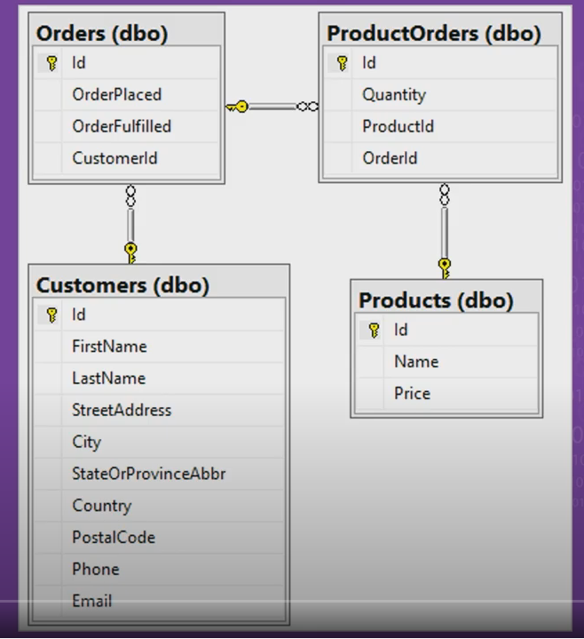
Goal
Build API
Data: shop
Database: local SQL server

Slide 12
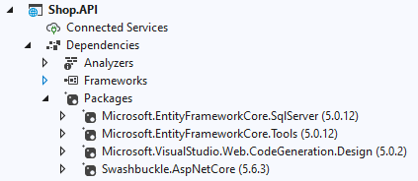
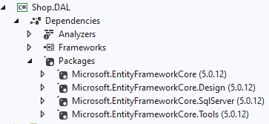
DAL Project (Models, REPO, UOW)
To maintain a well-structured overview, all data access related elements are assembled in a new class library project Shop.DAL
Add new project
Class library – Shop.DAL
Add Project Reference in Shop.API to Shop.DAL
Install the EF Core NuGet packages (Core/Design/SqlServer/Tools) in Shop.DAL
Install the EF Core NuGet packages (SqlServer/Tools) in Shop.API
It is important that both applications use this same version of EF (5.0.12)

Slide 13
Models (in Shop.DAL)
The model collection is a set of classes that represents the data managed by the API
Our models
Product
Customer
Order
ProductOrder
Create classes for these models in a new ‘Models’ folder in Shop.DAL (copy from resources on Canvas)

Slide 14
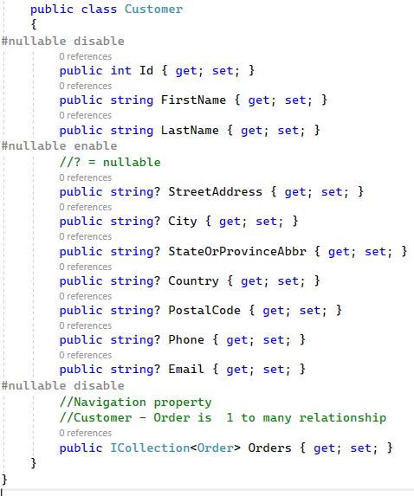
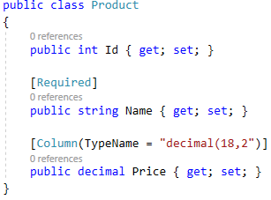
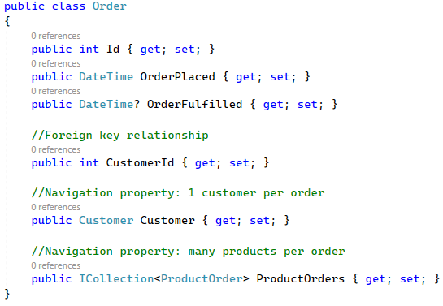
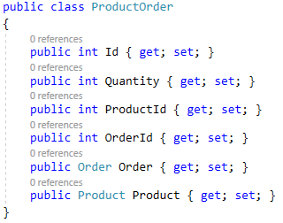
Models (in Shop.DAL)

Slide 15
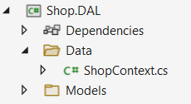
Database context (in Shop.DAL)
Create a new folder ‘Data’ in Shop.DAL
Create the DbContext ‘ShopContext.cs’ in this folder (copy from resources)
Through this ShopContext we want to query and update the database (connection injected in the constructor) public ShopContext(DbContextOptions<ShopContext> options)
In the ShopContext DBSets are created for the models public DbSet<Customer> Customers { get; set; }
The mapping to the actual tables in SQLServer is set modelBuilder.Entity<Customer>().ToTable("Customer");

Slide 16
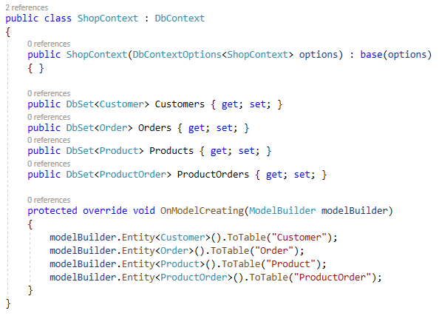
ShopContext.cs (in Shop.DAL)
Notes:
Microsoft.EntityFrameworkCore.Relational
Microsoft.EntityFrameworkCore
Microsoft.EntityFrameworkCore.SqlServer

Slide 17
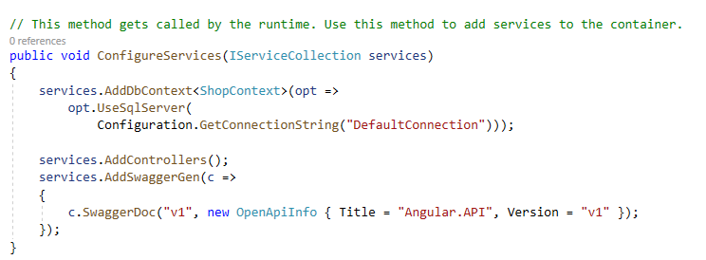
Register the database context (in Shop.API)
Shop.API Project
Startup.cs
ConfigureServices
Needs to be registered in appsettings.json
Notes:
services.AddDbContext<ShopContext>(opt =>
opt.UseSqlServer(
Configuration.GetConnectionString("DefaultConnection")));

Slide 18
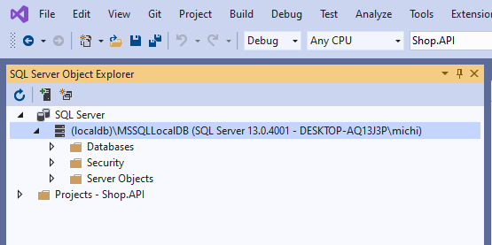
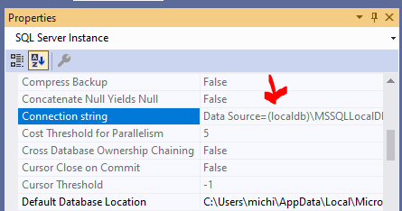
Get the connectionstring
Right click (localdb)\MSSQLLocalDB and choose ‘properties’
Copy the connection string

Slide 19
DefaultConnection (in Shop.API)
Open appsettings.json
Add ConnectionStrings Add DefaultConnection key-value pair
Paste the retrieved connection string
Change Initial Catalog from master to ‘ShopAPI’ = database name
{ "ConnectionStrings": { "DefaultConnection": "Data Source=(localdb)\\MSSQLLocalDB;Initial Catalog=ShopAPI;Integrated Security=True;Connect Timeout=30;Encrypt=False;TrustServerCertificate=False;ApplicationIntent=ReadWrite;MultiSubnetFailover=False" }, "Logging": { ...

Slide 20

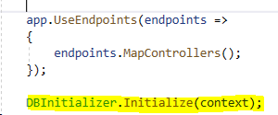
DBInitializer
Shop.DAL
Copy DBInitializer.cs from the resources in the Data folder
Shop.API
Extend the Configure method in the Startup.cs
Add ShopContext context to the constructor
Execute the Initialize method of the DBInitializer

Slide 21
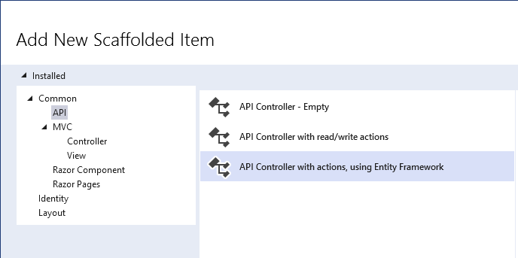
Add a controller (in Shop.API)
Richt click ‘Controllers’ folder – Add – Controller – API:
Before you can use scaffolding make sure the Web.CodeGeneration.Design library (5.0.2) is available If not → NuGet

Slide 22
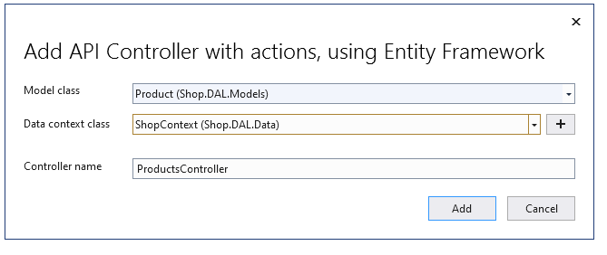
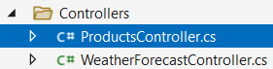
Add a controller for product (in Shop.API)

Slide 23
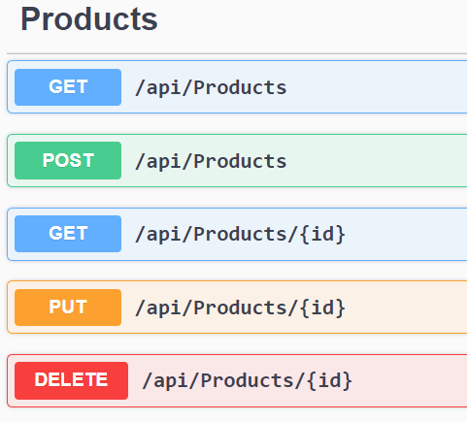
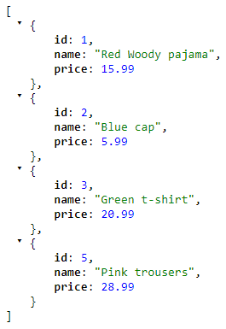
ProductsController
Ready to go! Ctrl + F5 (Swagger)
Try out the GET (Swagger)
Or: https://localhost:44372/api/products

Slide 24
ProductsController
HTTP | Action method | Result
[HttpGet] | GetProducts() | Returns all the products
[HttpGet("{id}")] | GetProduct(int id) | Returns a specific product based on the id
[HttpPut("{id}")] | PutProduct(int id, Product product) | Updates a product
[HttpPost] | PostProduct(Product product) | Adds a product
[HttpDelete("{id}")] | DeleteProduct(int id) | Deletes a product based on the id

Slide 25
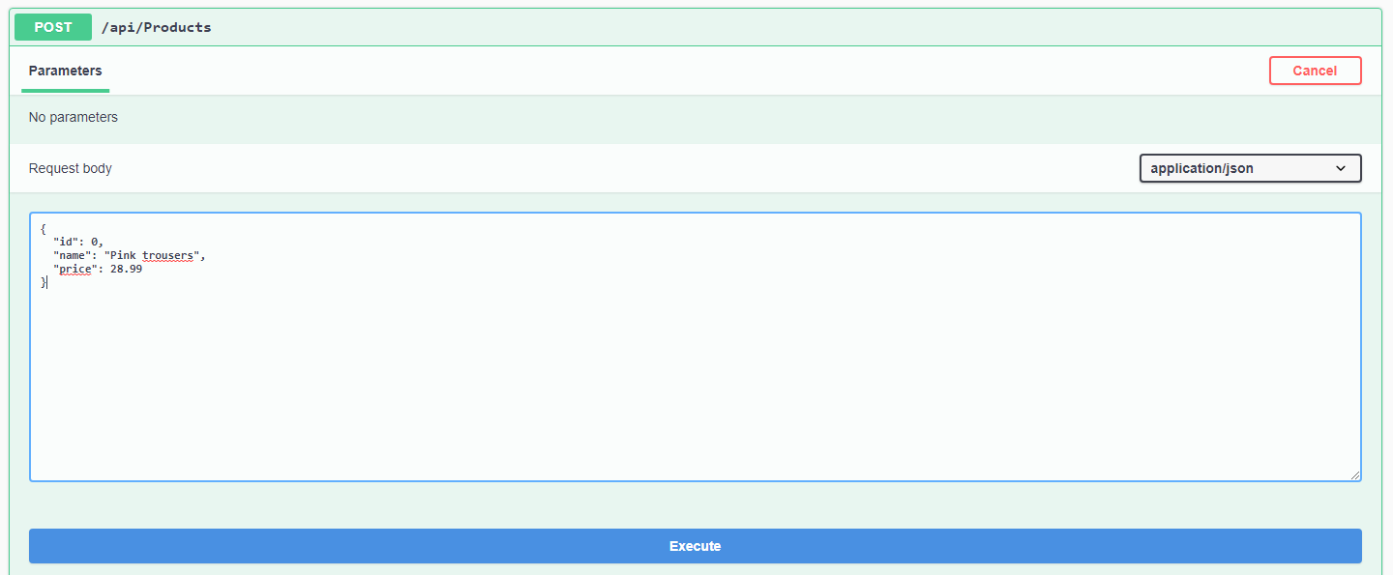
Swagger - Post
POST a new product!
{
"id": 0,
"name": "Pink trousers",
"price": 28.99
}
Product id stays 0 The id will be generated

Slide 26
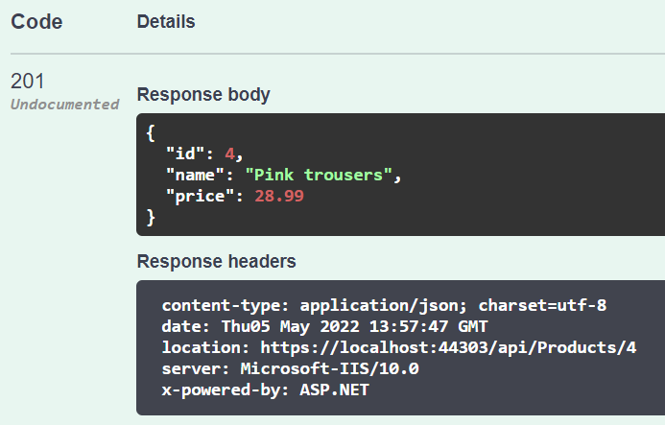
Swagger – Post - Result
Product id is automatically set

Slide 27
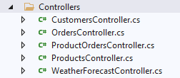
More controllers
Create the controllers for the other models via scaffolding

Slide 28
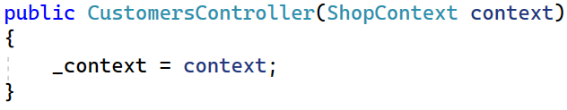
Repository & UnitofWork (UoW)
Generating these controllers results in the ‘ShopContext’ directly injected in the constructor of the controller.
As we know this is NOT testable
→ Let’s implement the Repository and UoW Data Access patterns

Slide 29
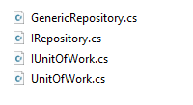
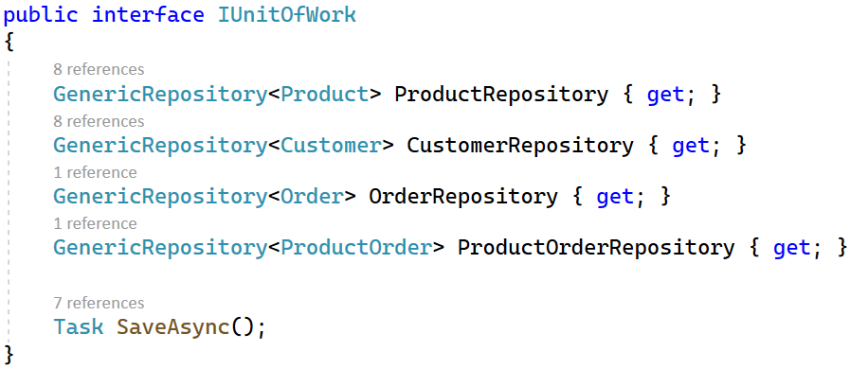
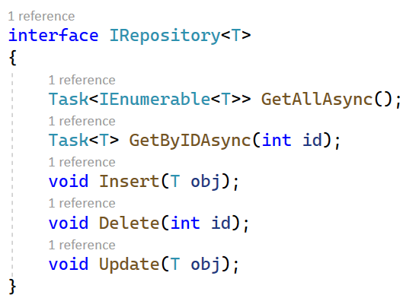
Repository & UoW
Find the following files in the Resources folder and copy them to the root of the Shop.DAL project:
Notice that these interfaces and classes work asynchronously:

Slide 30
Repository & UoW
Do not forget to register the UoW interface + implementation in Startup.cs (in Shop.API)
services.AddScoped<IUnitOfWork, UnitOfWork>();
Refactor the controllers so that they work with the UnitOfWork

Slide 31
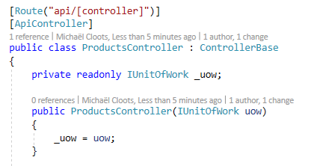
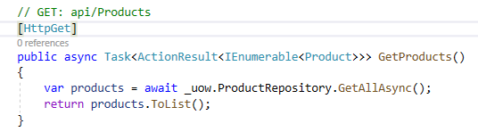
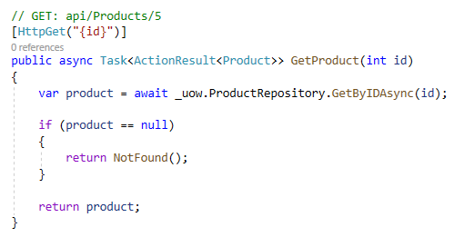
ProductsController
Because we scaffolded the controllers all the actions work asynchronously.

Slide 32
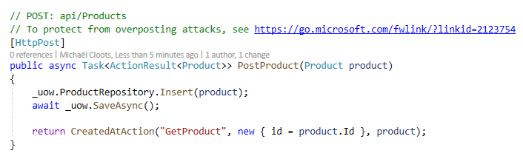
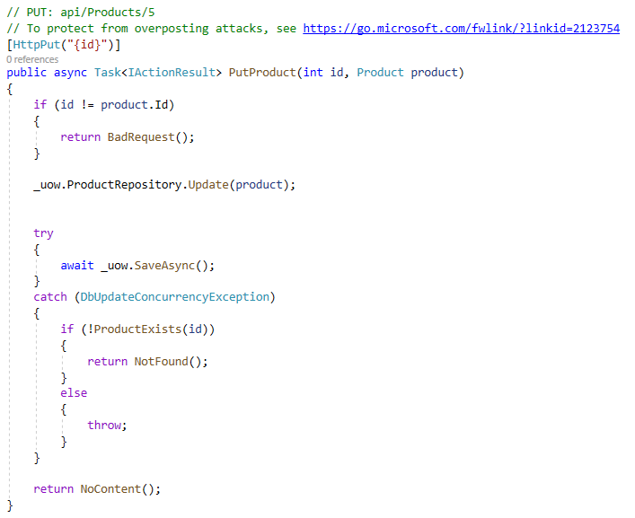
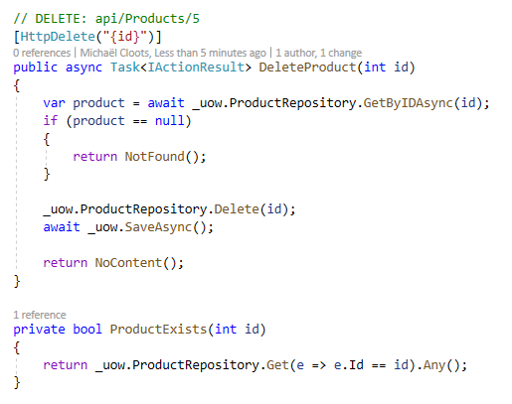
Productscontroller

Slide 33
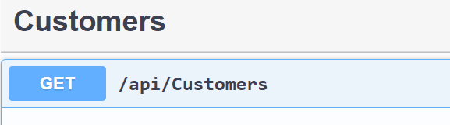
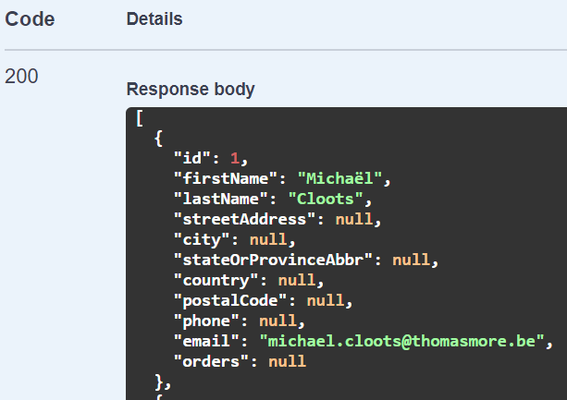
Run and test
Run the API (Ctrl + F5)
Test Customers GET using the Swagger interface

Slide 34
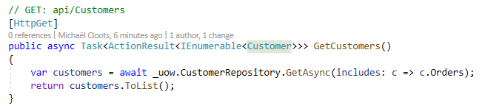
Customer - Order
Corresponding orders (a customer has 0 - * orders) are not loaded.
Include the orders in the GetCustomers() method

Slide 35
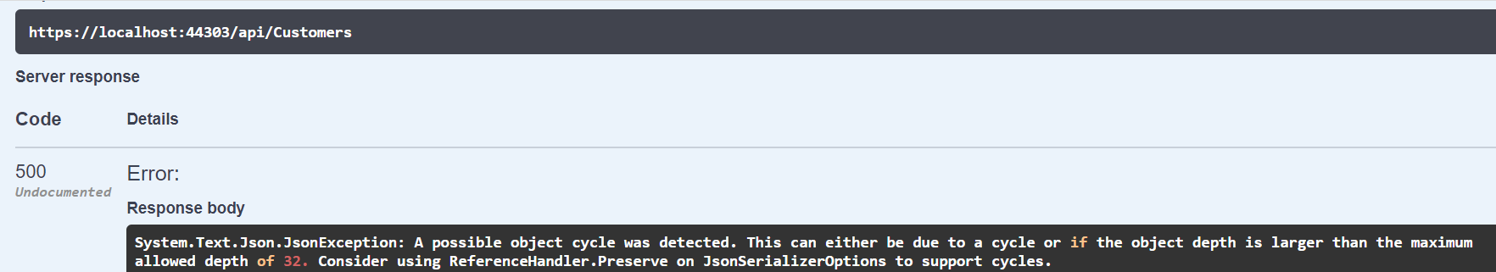
Run and test
Test Customers GET using the Swagger interface
Circular reference detected!
Notes:
We try to serialize an object using Newtonsoft.Json but there’s a circular reference (Parent – Child – Parent). The Parent object Customer has a reference to a Child object Order, which has a back reference to the Parent object Customer.

Slide 36
Solution for avoiding object cycles
Go to Startup.cs in Shop.API
using System.Text.Json.Serialization;
Add in ConfigureServices()
services.AddControllers().AddJsonOptions(x => x.JsonSerializerOptions.ReferenceHandler = ReferenceHandler.Preserve);

Slide 37
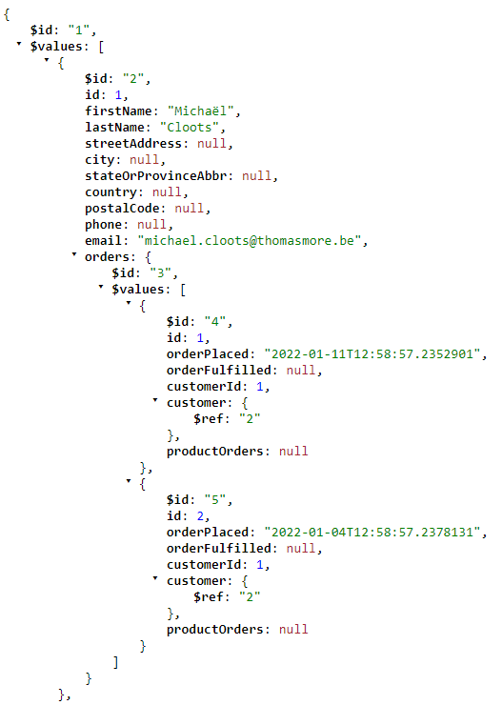
Result – GetCustomers()
Customer and corresponding orders are loaded.

Slide 38
CORS
App = localhost:XXXX
API = localhost:YYYY
Different domain = trouble!
Security errors when calling API in App
Cross-Origin Resource Sharing is a way to solve this

Slide 39
CORS
Startup – ConfigureServices - Before AddControllers!
Startup – Configure – Right after UseRouting()!
services.AddCors(o => o.AddPolicy("MyPolicy", builder => { builder.AllowAnyOrigin() .AllowAnyMethod() .AllowAnyHeader(); }));
app.UseCors("MyPolicy");

